Slide 1
Chapter 12
Design via State Space

Slide 2
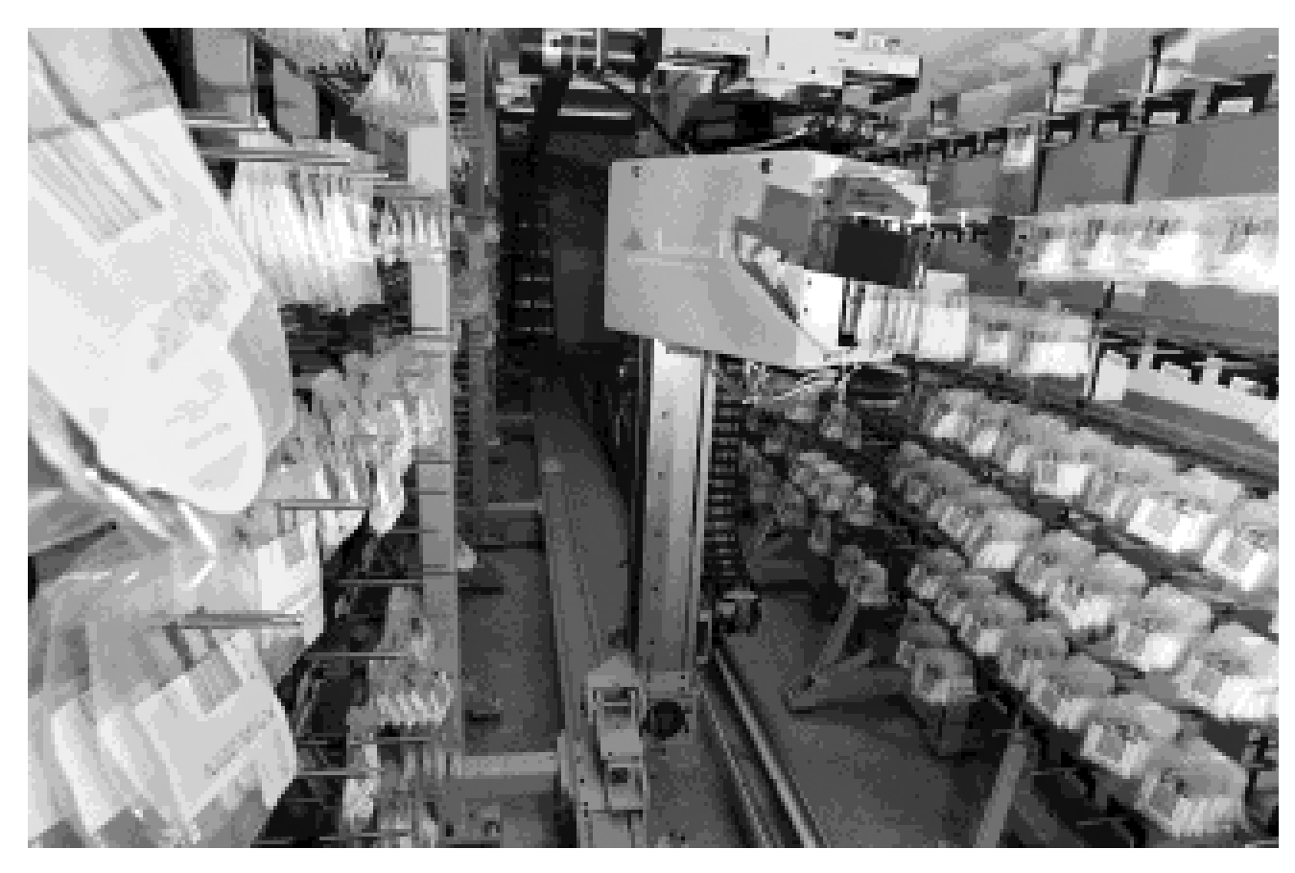
Figure 12.1
An automatic
pharmacy system
showing a robot
picking up drugs to
deposit in boxes for
individual patients at
a hospital

Slide 3
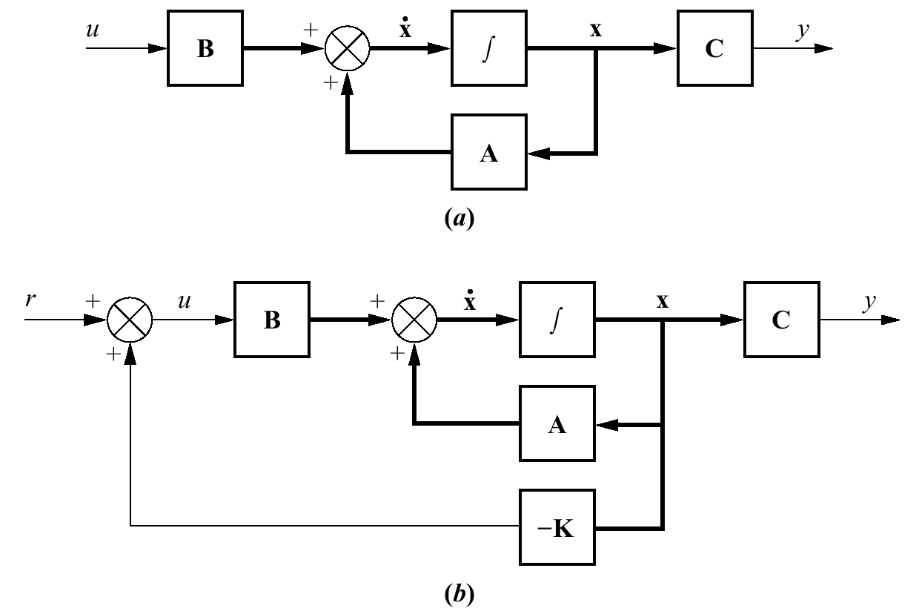
Figure 12.2
a. State-space
representation
of a plant;
b. plant with state-
feedback

Slide 4
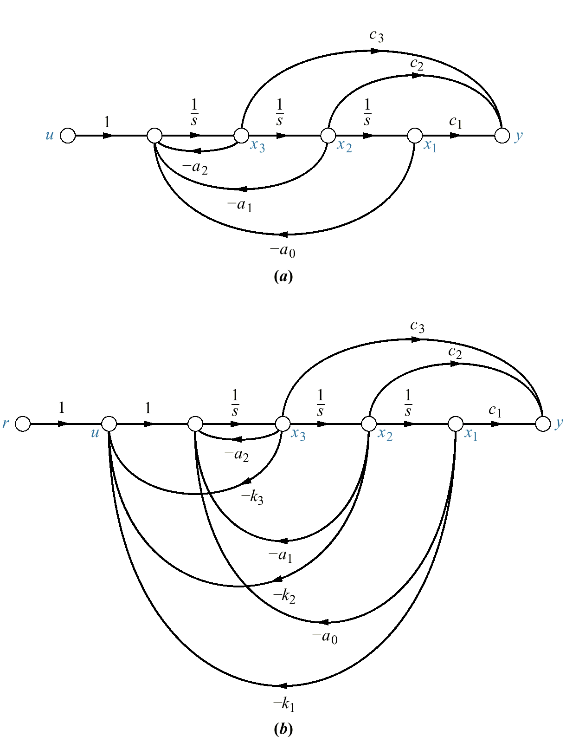
Figure 12.3
a. Phase- variable
representation for plant;
b. plant with state-
variable feedback

Slide 5
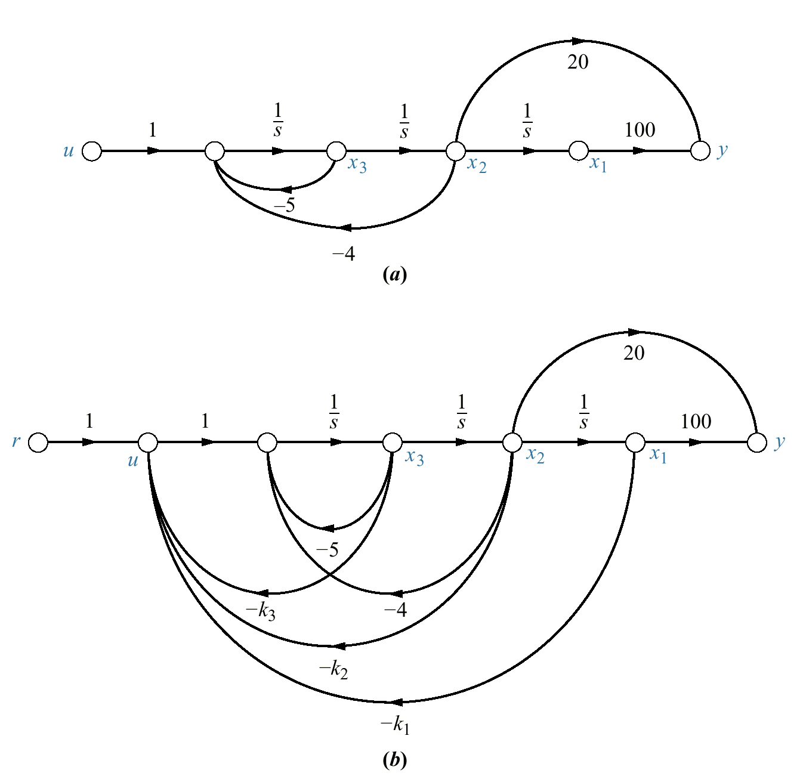
Figure 12.4
a. Phase-variable
representation for
plant of Example 12.1;
b. plant with state-
variable feedback

Slide 6
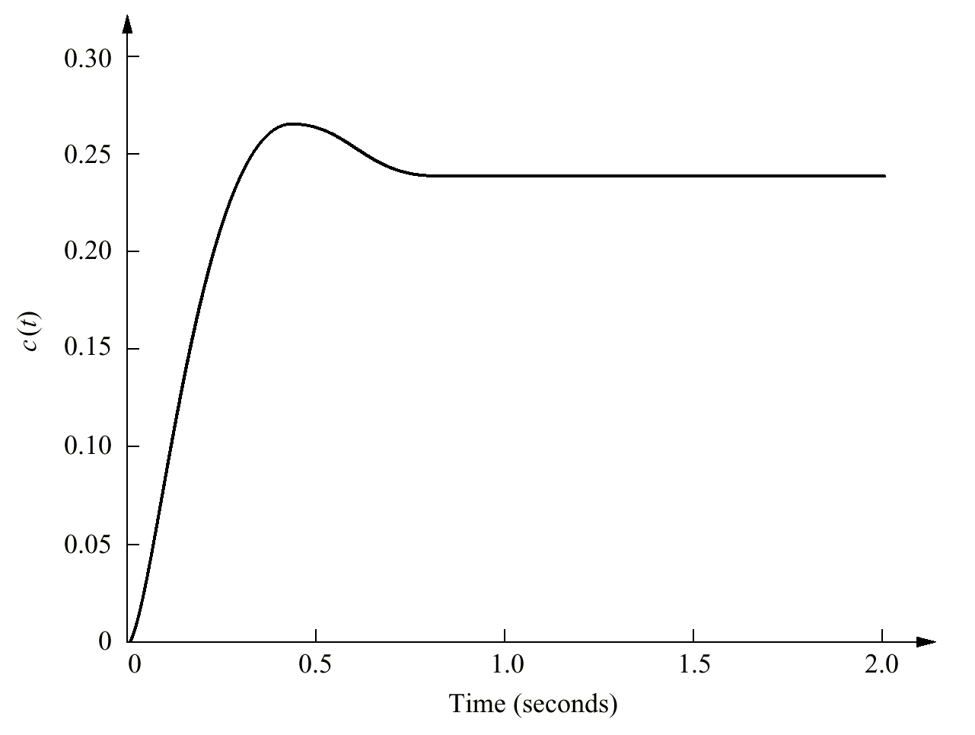
Figure 12.5
Simulation of closed-loop
system of
Example 12.1

Slide 7
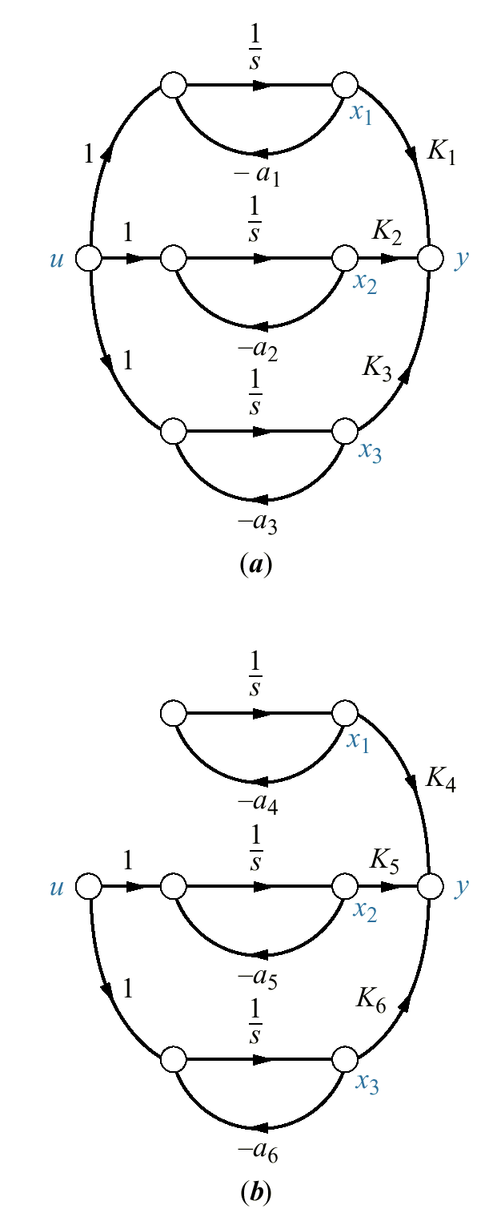
Figure 12.6
Comparison of
a. controllable and
b. uncontrollable
systems

Slide 8
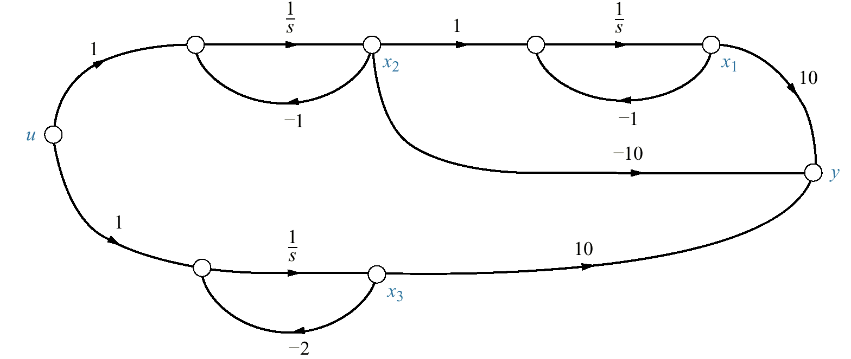
Figure 12.7
System for
Example 12.2

Slide 9
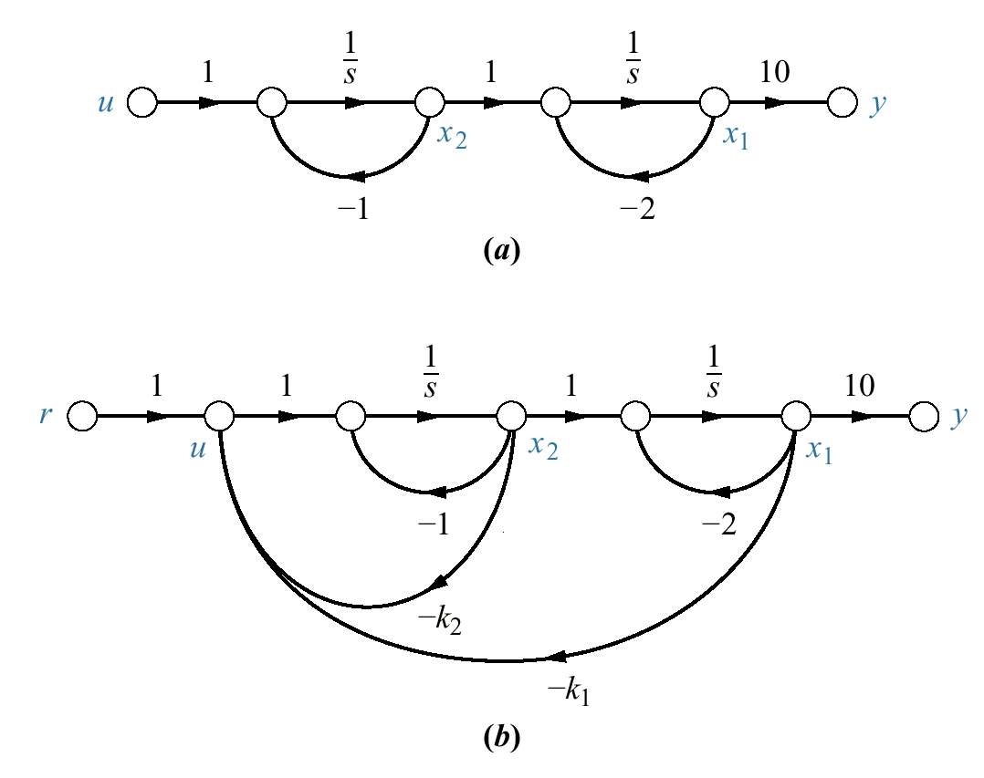
Figure 12.8
a. Signal-flow
graph in cascade
form for G(s ) =
10/[(s + 1)(s + 2)];
b. system with state
feedback added

Slide 10
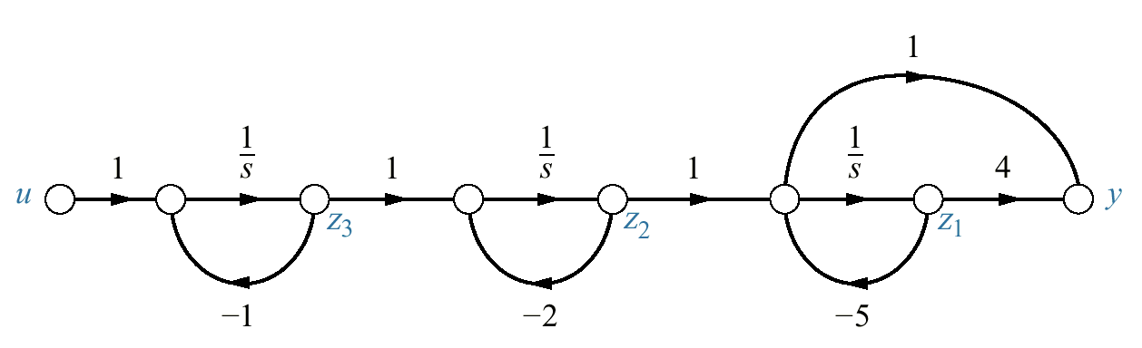
Figure 12.9
Signal-flow graph for
plant of Example 12.4

Slide 11
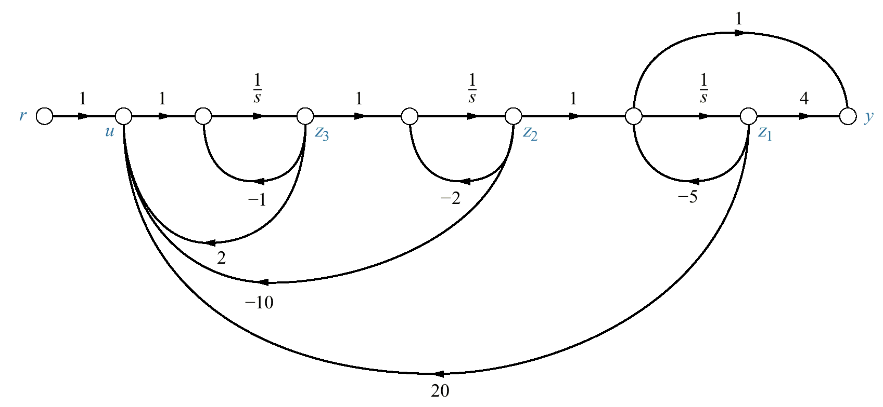
Figure 12.10
Designed system
with state-variable
feedback for
Example 12.4

Slide 12
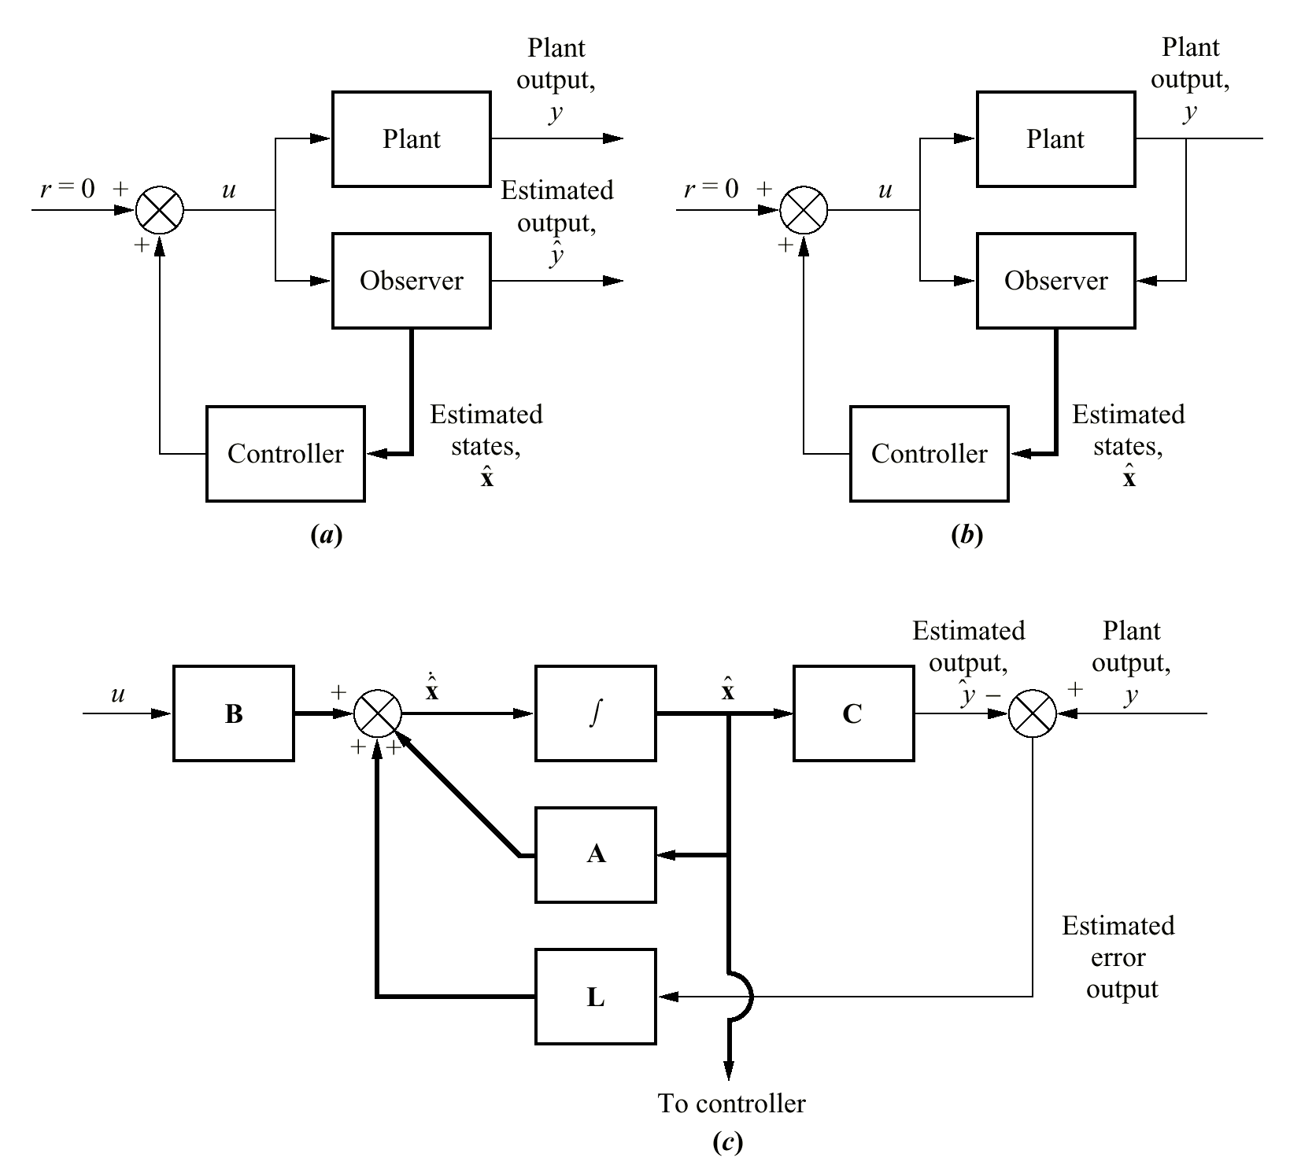
Figure 12.11
State-feedback design
using an observer to
estimate unavailable
state variables:
a. open-loop
observer;
b. closed-loop
observer;
c. exploded view of a
closed- loop observer,
showing feedback
arrangement to
reduce state-variable
estimation error

Slide 13
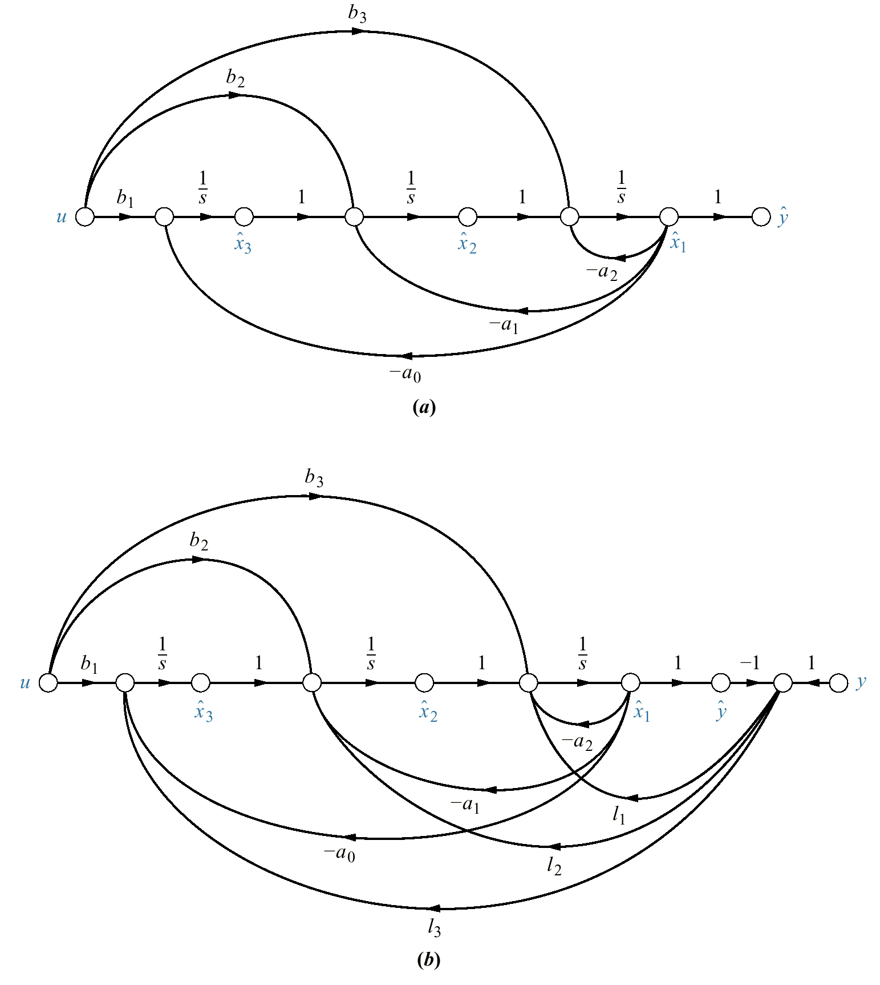
Figure 12.12
Third-order observer in
observer canonical
form:
a. before the addition
of feedback;
b. after the addition of
feedback

Slide 14
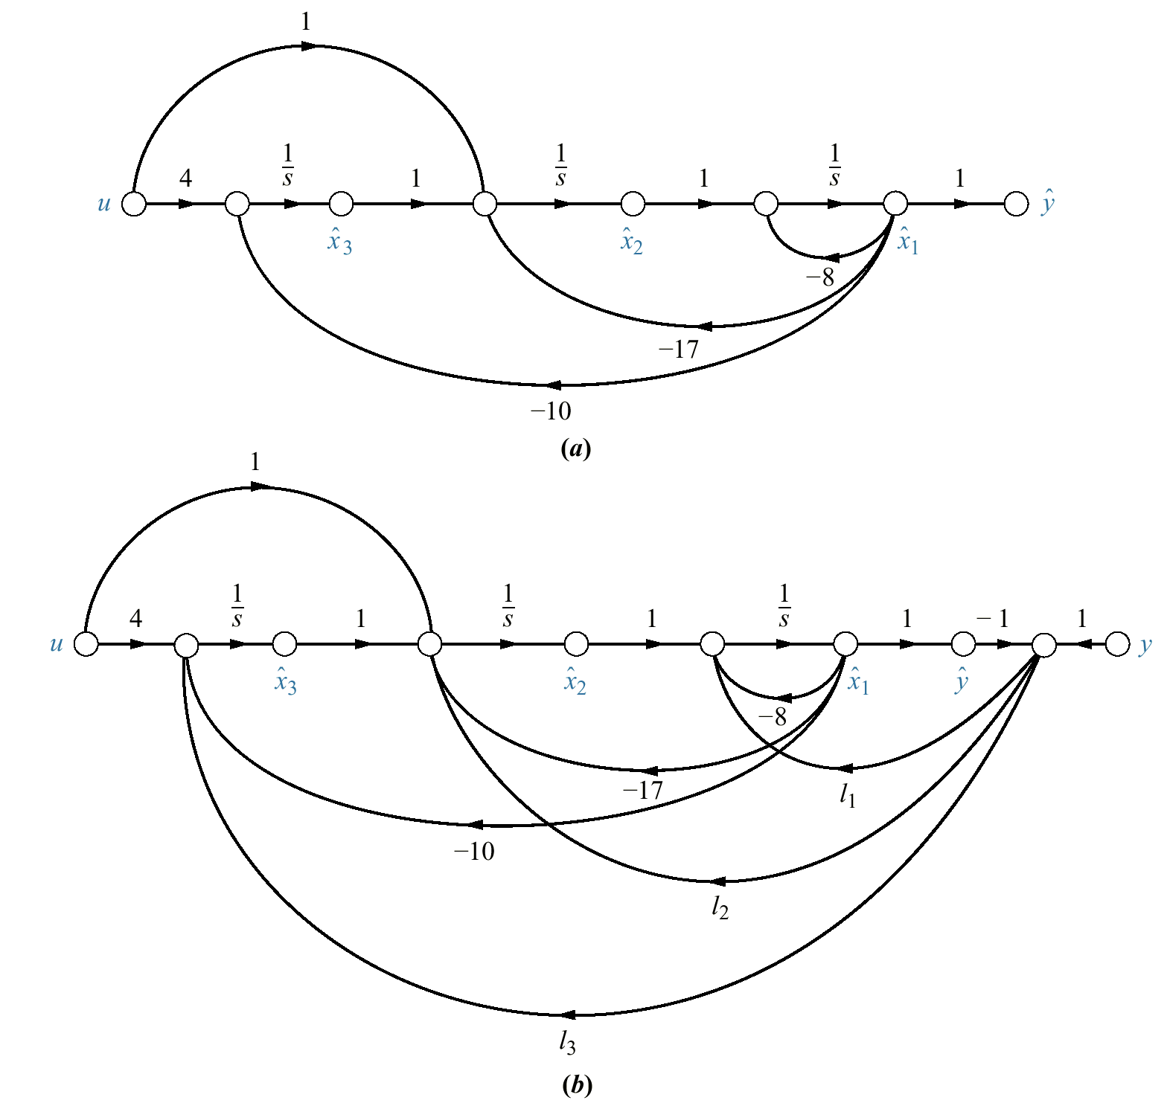
Figure 12.13
a. Signal-flow graph
of a system using
observer canonical
form variables;
b. additional feedback
to create observer

Slide 15
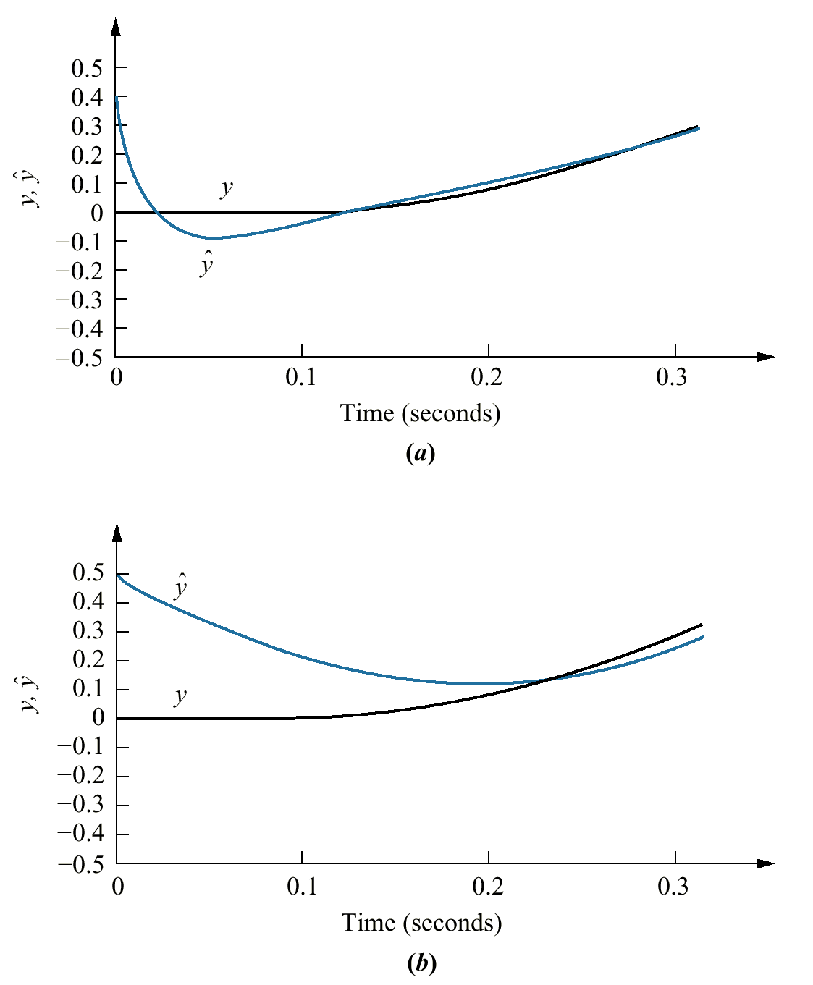
Figure 12.14
Simulation showing
response of observer:
a. closed-loop;
b. open-loop with
observer gains
disconnected

Slide 16
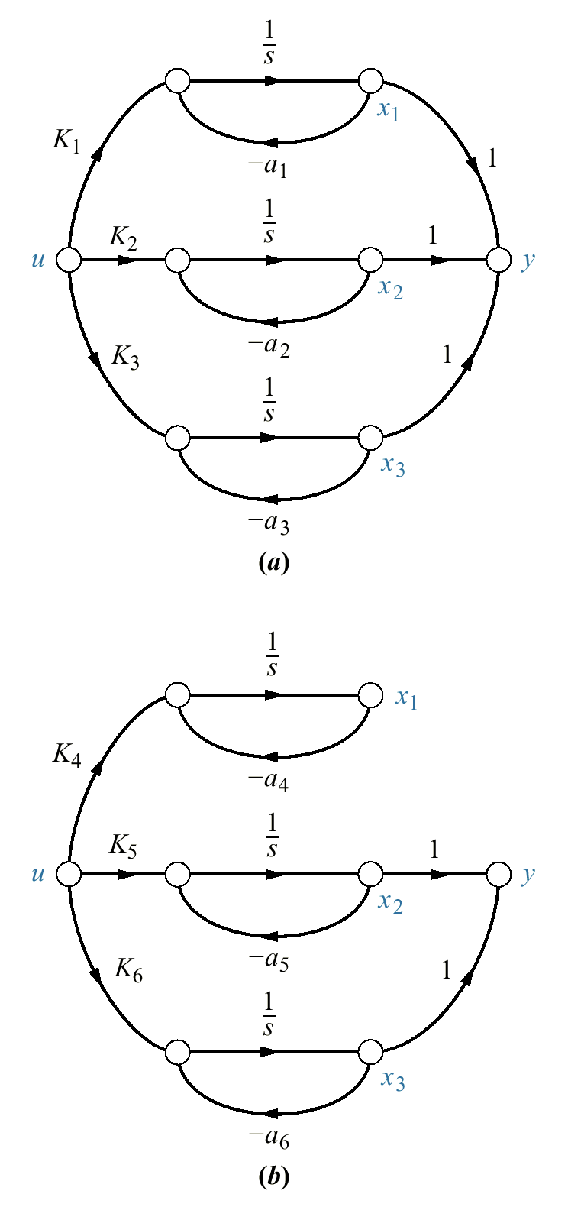
Figure 12.15
Comparison of
a. observable and
b. unobservable
systems

Slide 17
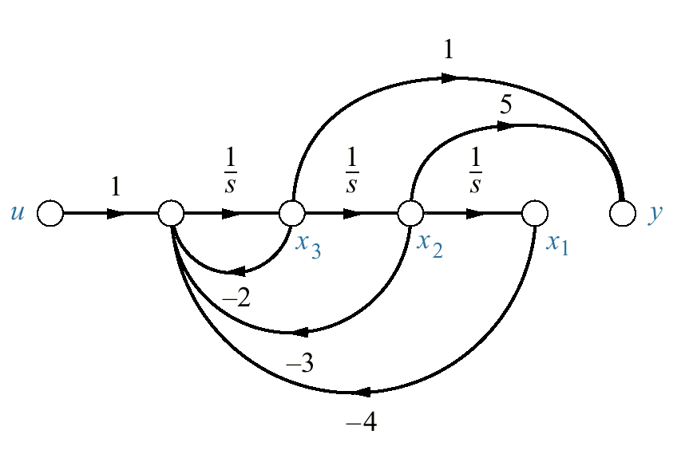
Figure 12.16
System of
Example 12.6

Slide 18
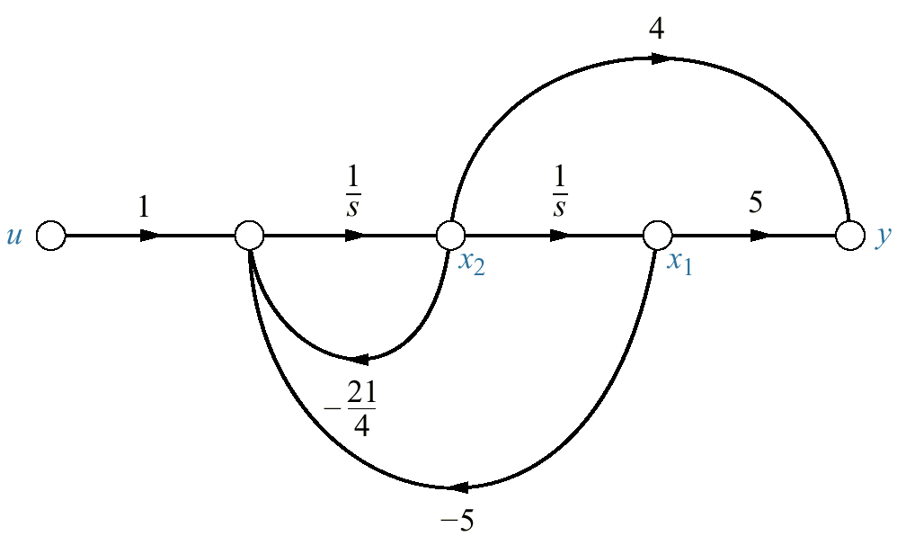
Figure 12.17
System of
Example 12.7

Slide 19
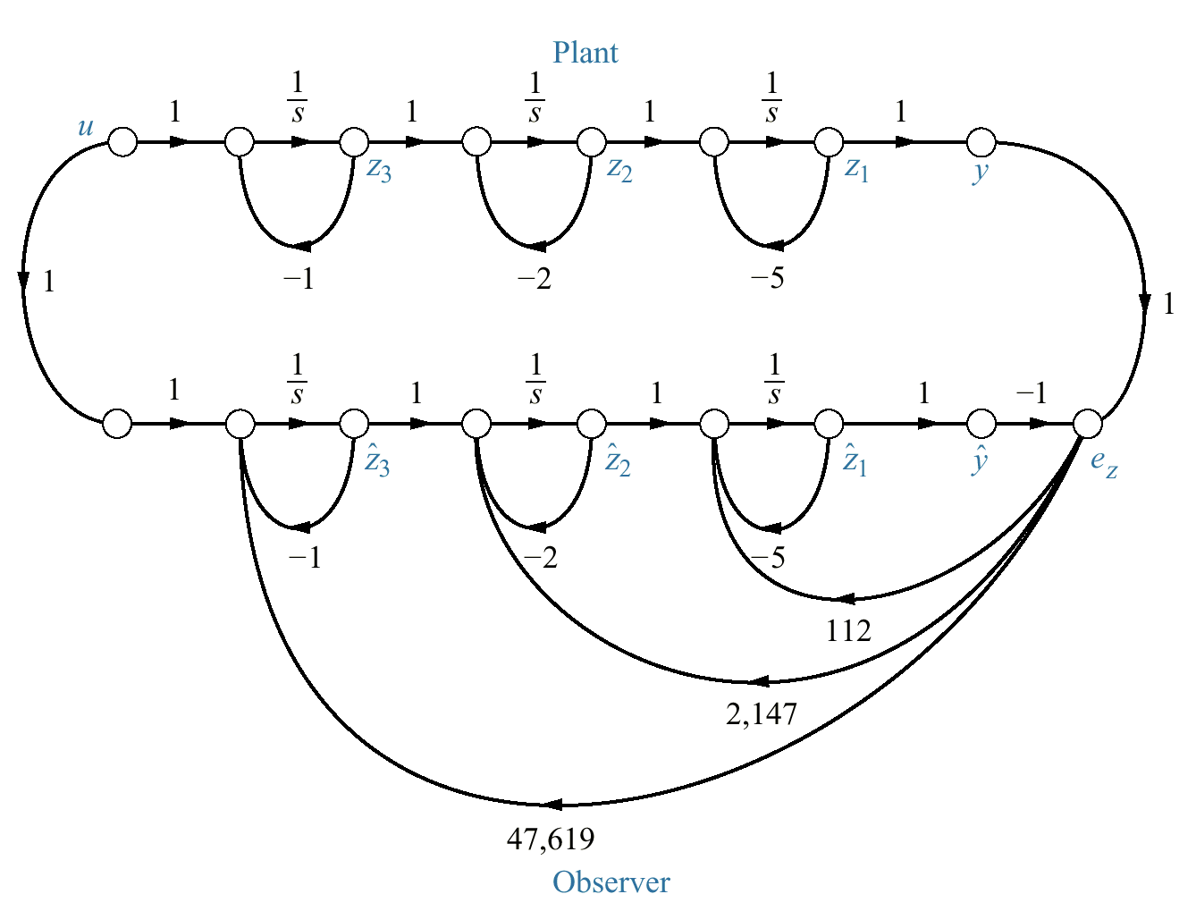
Figure 12.18
Observer design

Slide 20
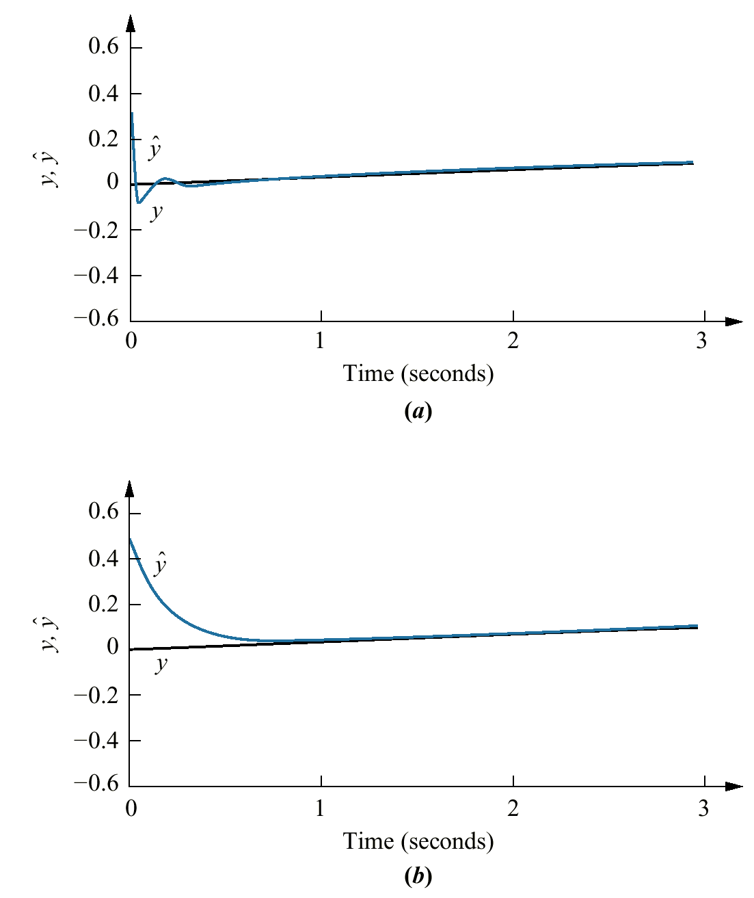
Figure 12.19
Observer design step
response simulation:
a. closed-loop
observer;
b. open-loop observer
with observer gains
disconnected

Slide 21
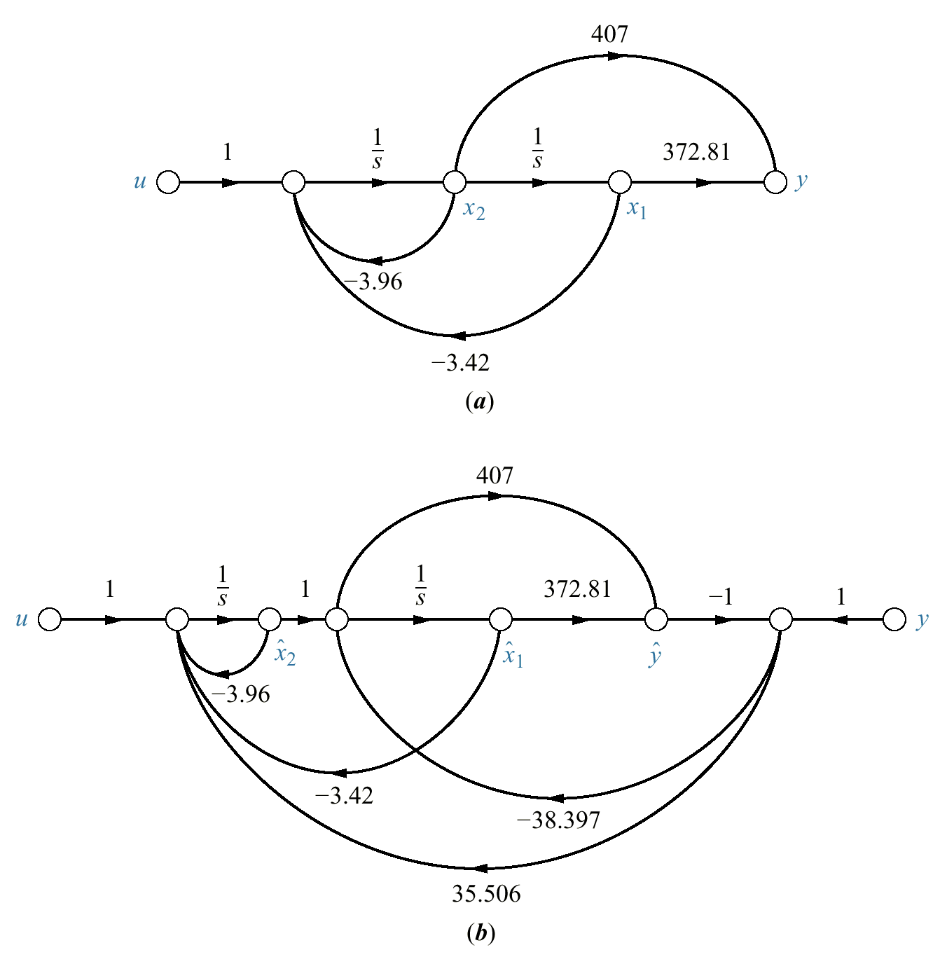
Figure 12.20
a. Plant;
b. designed observer
for Example 12.9

Slide 22
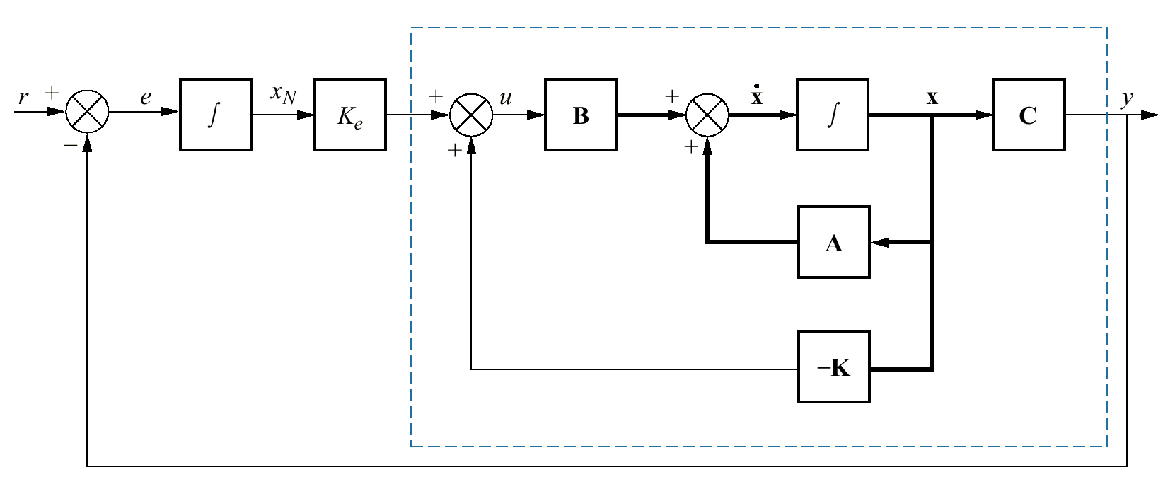
Figure 12.21
Integral control for
steady-state error
design

Slide 23
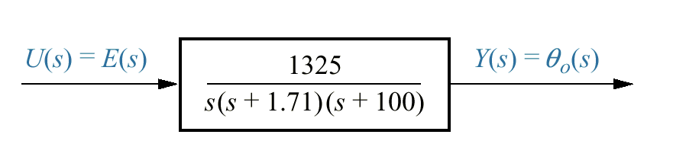
Figure 12.22
Simplified block
diagram of antenna
control system
shown on the
front endpapers
(Configuration 1)
with K = 200

Slide 24
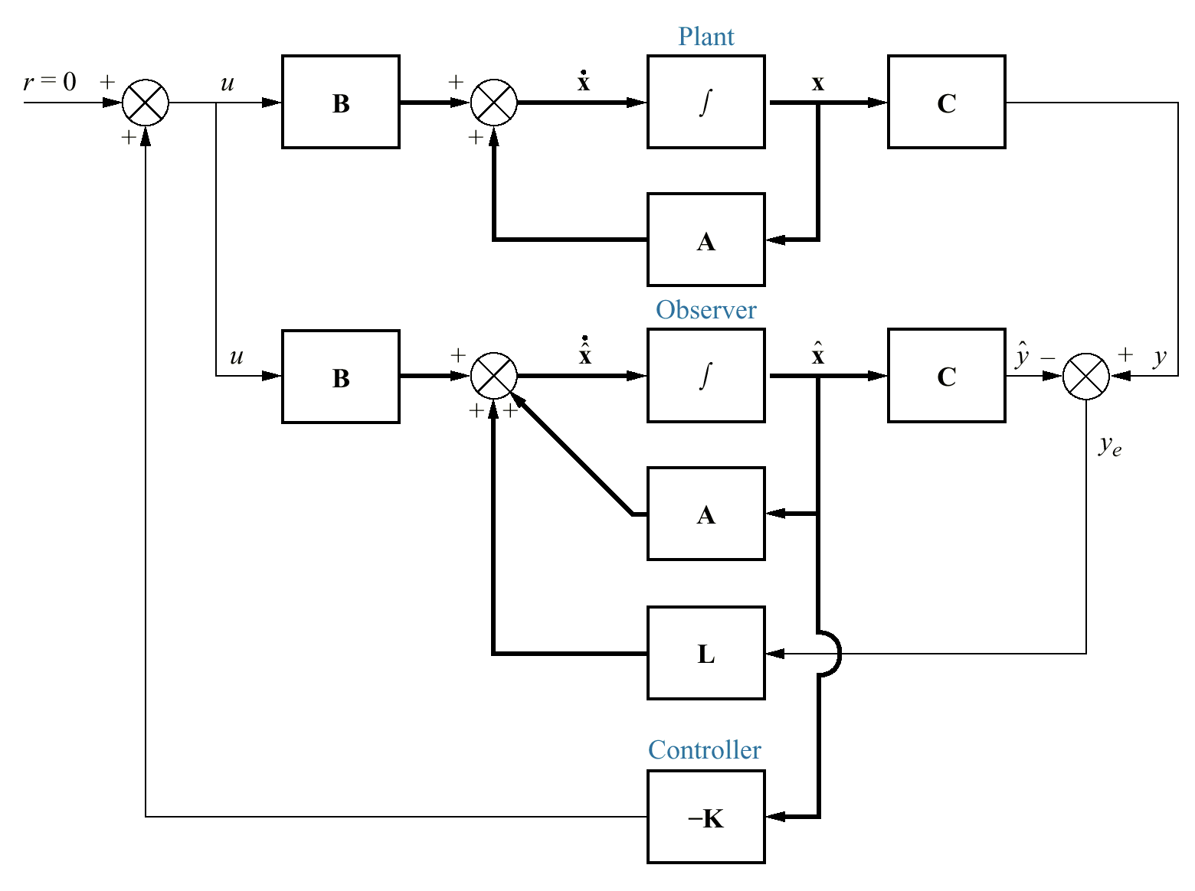
Figure 12.23
Conceptual state-
space design
configuration, showing
plant, observer, and
controller

Slide 25
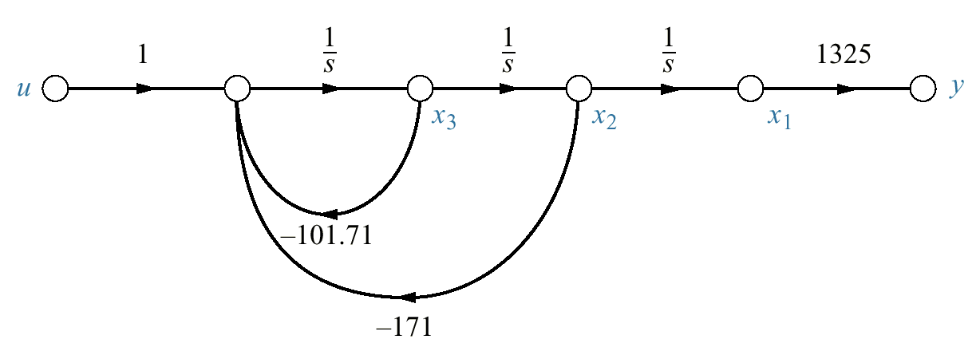
Figure 12.24
Signal- flow graph for
G(s) = 1325/
[ s(s² + 101.71s +
171)]

Slide 26
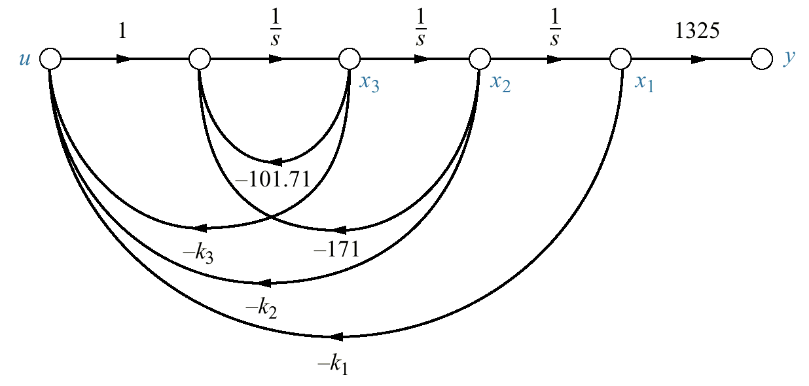
Figure 12.25
Plant with state-
variable feedback for
controller design

Slide 27
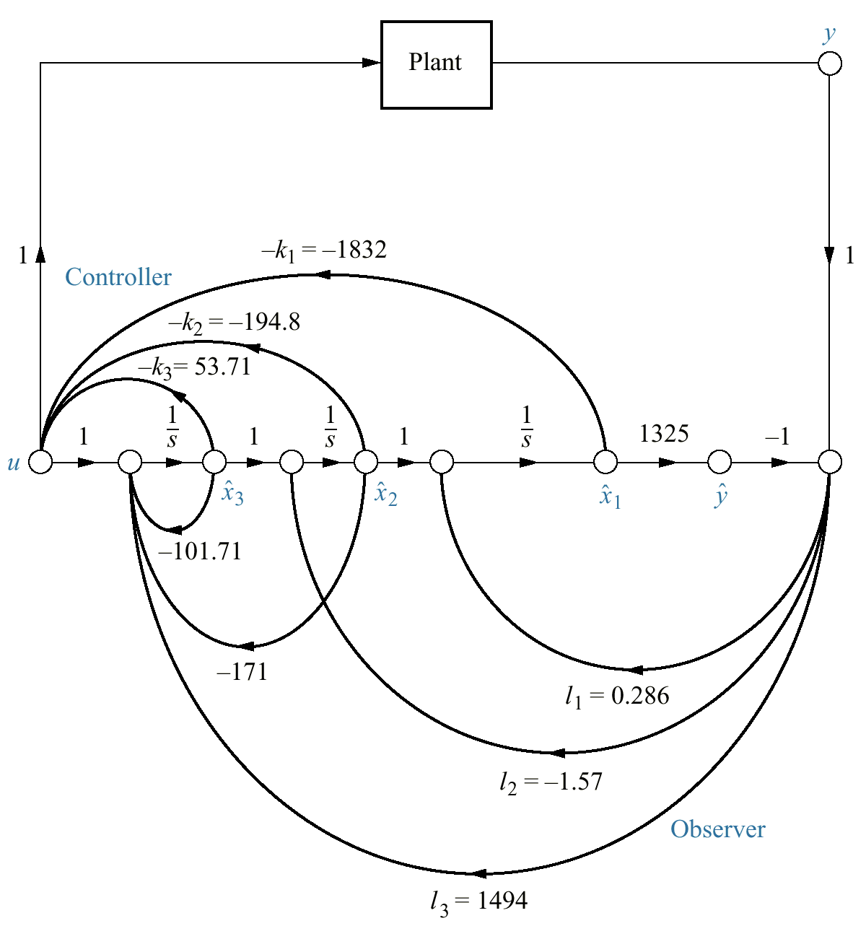
Figure 12.26
Completed state-
space design for
the antenna azimuth
position control
system, showing
controller and
observer

Slide 28
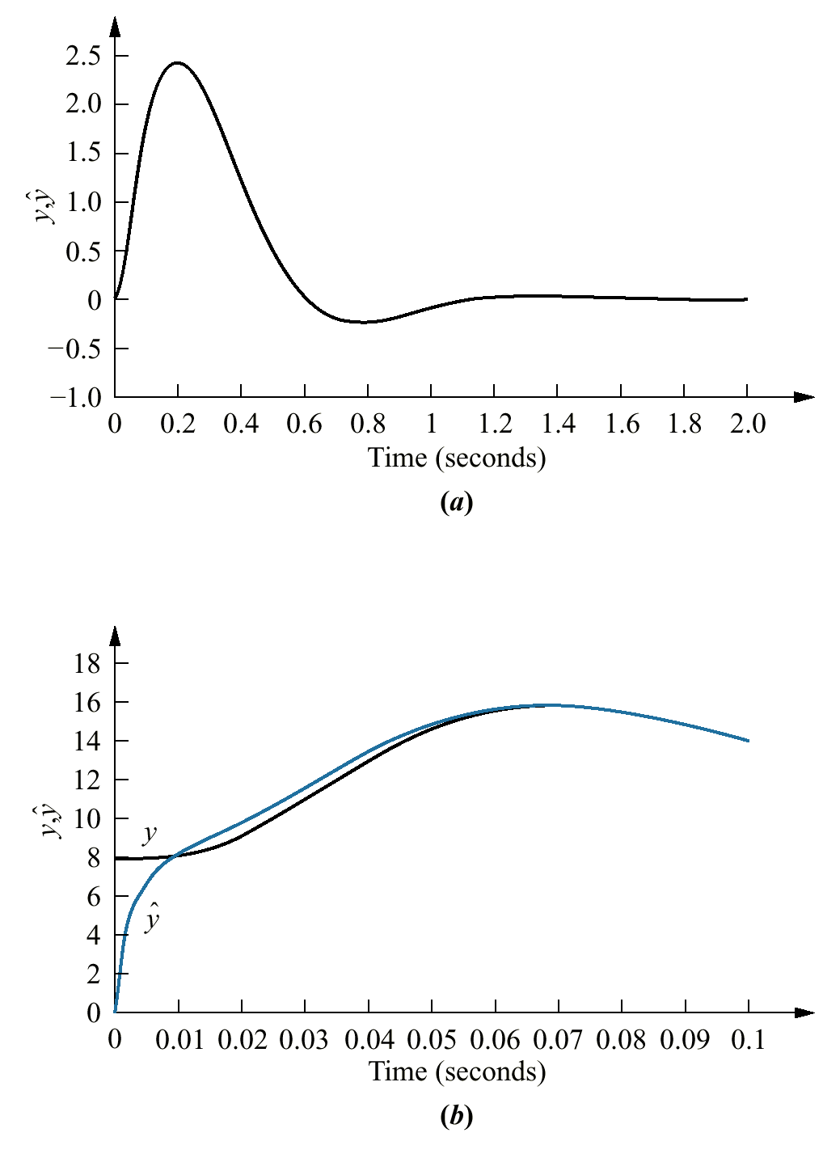


Figure 12.27
Designed response
of antenna azimuth
position control system:
a. impulse response—
plant and observer
with the same initial
conditions, x₁(0) =
b. portion of impulse
response—plant and
observer with different
initial conditions,
x₁(0) = 0.006 for
the plant,
for the observer

Slide 29
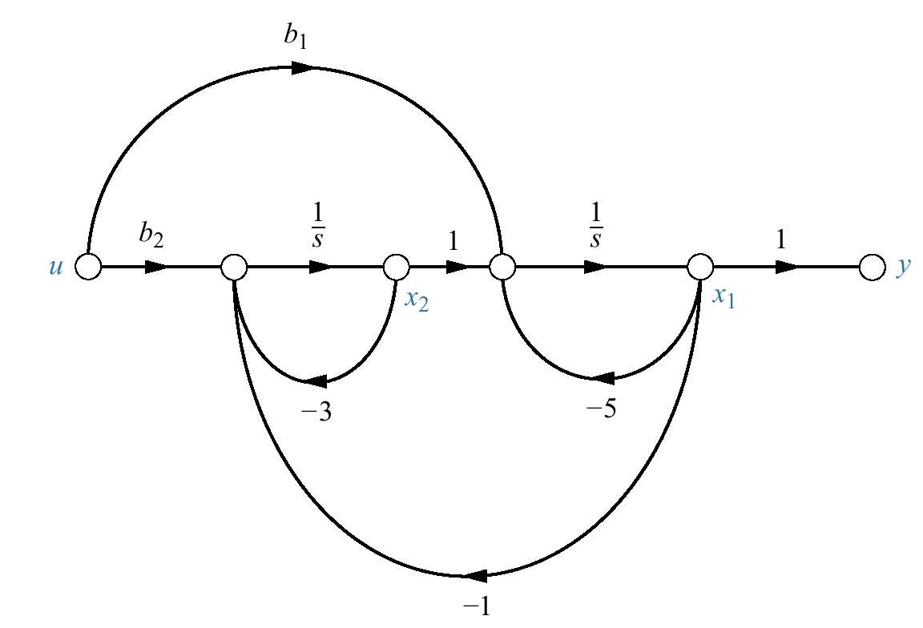
Figure P12.1

Slide 30
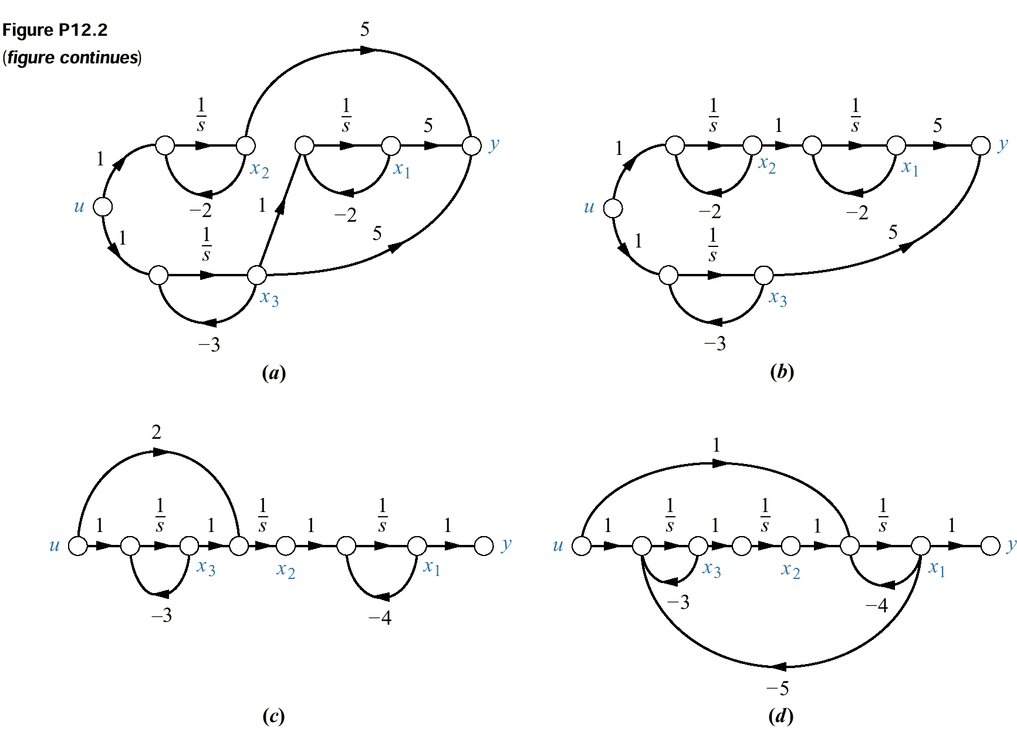
Figure P12.2
(figure continues)

Slide 31
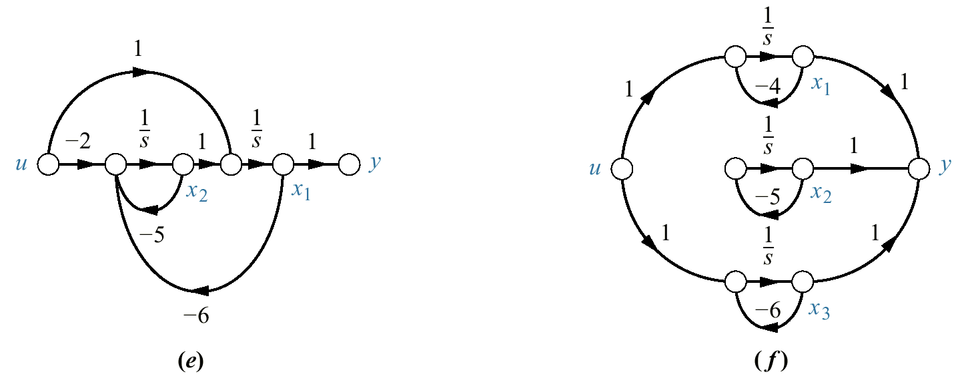
Figure P12.2
(continued)

Slide 32
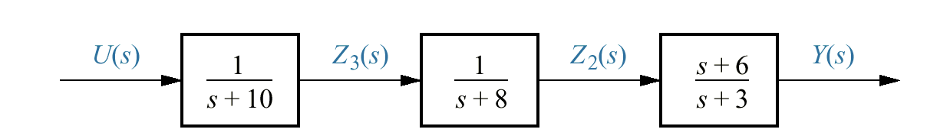
Figure P12.3

Slide 33
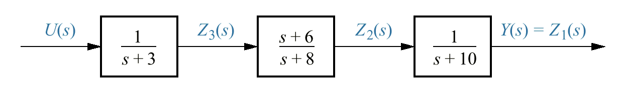
Figure P12.4

Slide 34
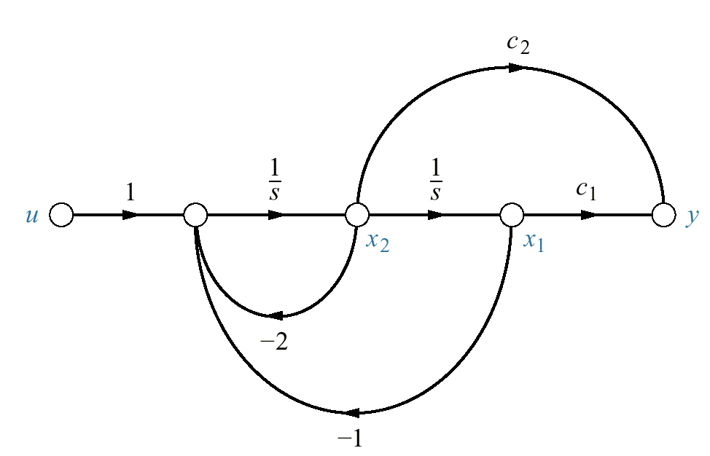
Figure P12.5

Slide 35
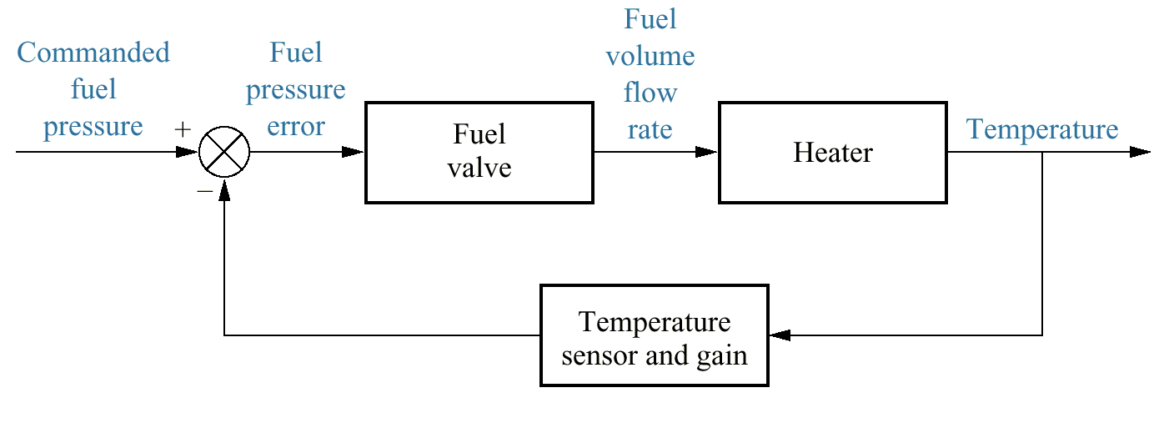
Figure P12.6
Block diagram of a
gas-fired heater

